Slide 1
Memory Interfacing with 8088 Microprocessor

Slide 2
Fundamentals
Address decoding
Glue logic
Type of memory (RAM or ROM)
Memory map
Labelling the schematic
Reverse engineering the schematic (determining memory map, memory size and type of memory etc.)

Slide 3
Interfacing Random Access Memory

Slide 4
Recall the SRAM
Data Bus
Address Bus
Order of memory
Control Bus or Control Lines
(OE’, WR’, CS’(CE’ or ME’)
Power lines (Vcc and GND)
Tri-state or Z-state or High-impedance

Slide 5
Interfacing single SRAM chip

Slide 6
74LS138 3x8 Complementary Decoder

Slide 7
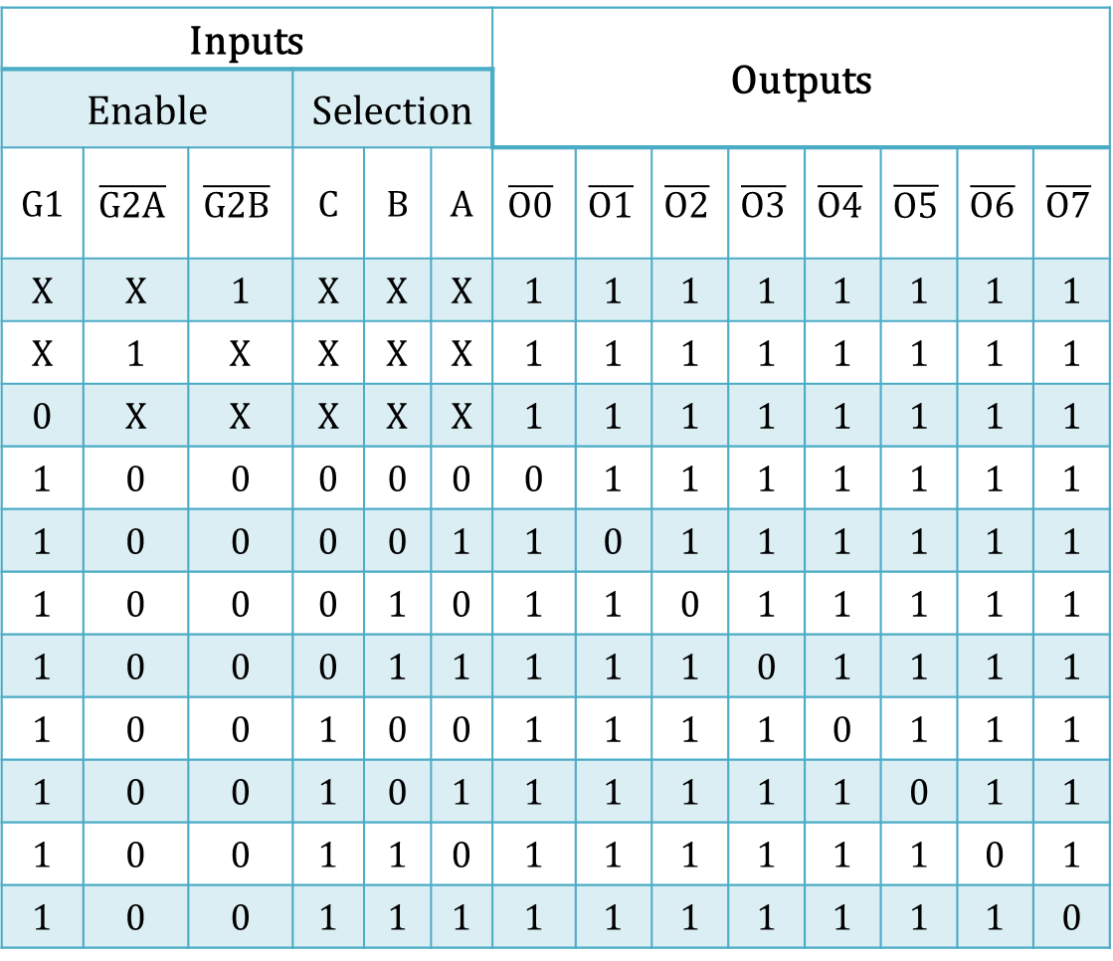
Truth Table of 74LS138
Inputs |  |  |  |  |  | Outputs
Enable |  |  | Selection
G1 | $$\overline{G2A}$$ | $$\overline{G2B}$$ | C | B | A | $$\overline{O0}$$ | $$\overline{O1}$$ | $$\overline{O2}$$ | $$\overline{O3}$$ | $$\overline{O4}$$ | $$\overline{O5}$$ | $$\overline{O6}$$ | $$\overline{O7}$$
X | X | 1 | X | X | X | 1 | 1 | 1 | 1 | 1 | 1 | 1 | 1
X | 1 | X | X | X | X | 1 | 1 | 1 | 1 | 1 | 1 | 1 | 1
0 | X | X | X | X | X | 1 | 1 | 1 | 1 | 1 | 1 | 1 | 1
1 | 0 | 0 | 0 | 0 | 0 | 0 | 1 | 1 | 1 | 1 | 1 | 1 | 1
1 | 0 | 0 | 0 | 0 | 1 | 1 | 0 | 1 | 1 | 1 | 1 | 1 | 1
1 | 0 | 0 | 0 | 1 | 0 | 1 | 1 | 0 | 1 | 1 | 1 | 1 | 1
1 | 0 | 0 | 0 | 1 | 1 | 1 | 1 | 1 | 0 | 1 | 1 | 1 | 1
1 | 0 | 0 | 1 | 0 | 0 | 1 | 1 | 1 | 1 | 0 | 1 | 1 | 1
1 | 0 | 0 | 1 | 0 | 1 | 1 | 1 | 1 | 1 | 1 | 0 | 1 | 1
1 | 0 | 0 | 1 | 1 | 0 | 1 | 1 | 1 | 1 | 1 | 1 | 0 | 1
1 | 0 | 0 | 1 | 1 | 1 | 1 | 1 | 1 | 1 | 1 | 1 | 1 | 0

Slide 8
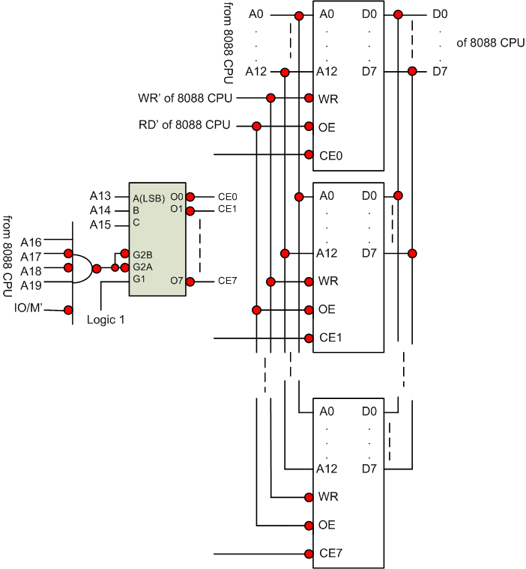

Slide 9
Interfacing Read-Only Memory

Slide 10
Some facts to know
In 8086 and 8088 CPUs, CS is FFFFH and IP is 0000H upon reset.
So FFFF0H location must be found in ROM.
Hence FFFF0H should contain the first instruction
As ROM cannot be written to, so WE pin is not available on ROM chips.

Slide 11
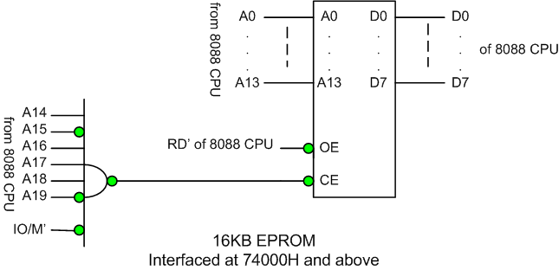
Interfacing a single ROM chip

Slide 12
